Slide 1
隱私資訊安全 Final Report
最後一組
M11215052 陳奕帆
M11215066 鄭宜珊
M11215032 葉品和

Slide 2
Paper
Optimization-based attack method: Deep Leakage from Gradients https://proceedings.neurips.cc/paper/2019/file/60a6c4002cc7b29142def8871531281a-Paper.pdf mit-han-lab/dlg: [NeurIPS 2019] Deep Leakage From Gradients (github.com)
Analytics-based attack method: R-GAP: Recursive gradient attack on privacy https://arxiv.org/pdf/2010.07733 JunyiZhu-AI/R-GAP: R-GAP: Recursive Gradient Attack on Privacy [Accepted at ICLR 2021] (github.com)

Slide 3
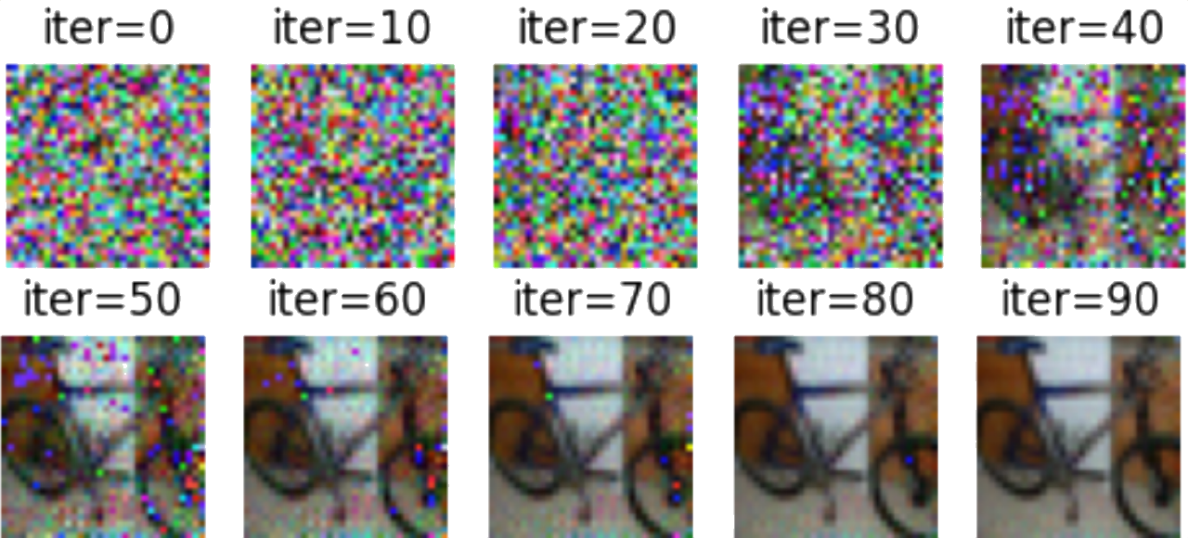
Result of restoration
DLG

Slide 4
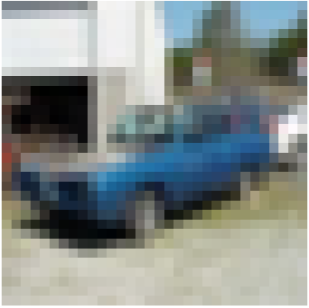
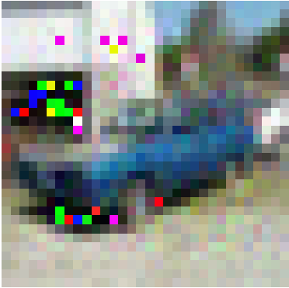
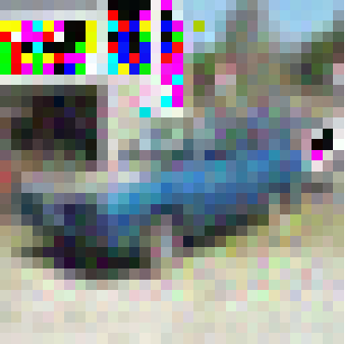
Result of restoration
R-GAP
Original
Reconstructed
Rescale Reconstructed

Slide 5
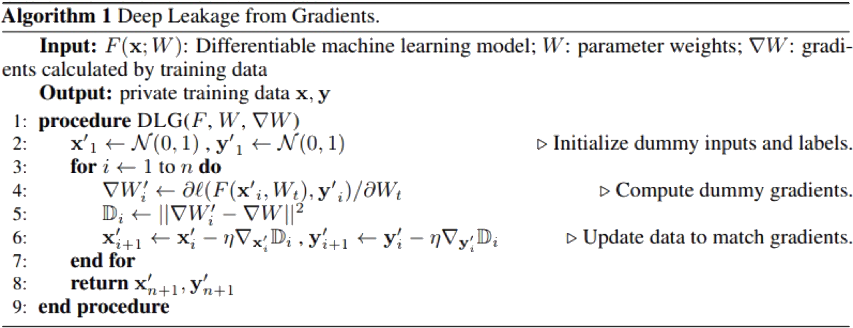
Comparison
DLG (Optimization-based)
Notes:
Generate random data & random label
Use random data to predict
Calculate loss between prediction and random label
Calculate gradient (fake)
Calculate difference between real and fake gradient
Finally get real data and label

Slide 6
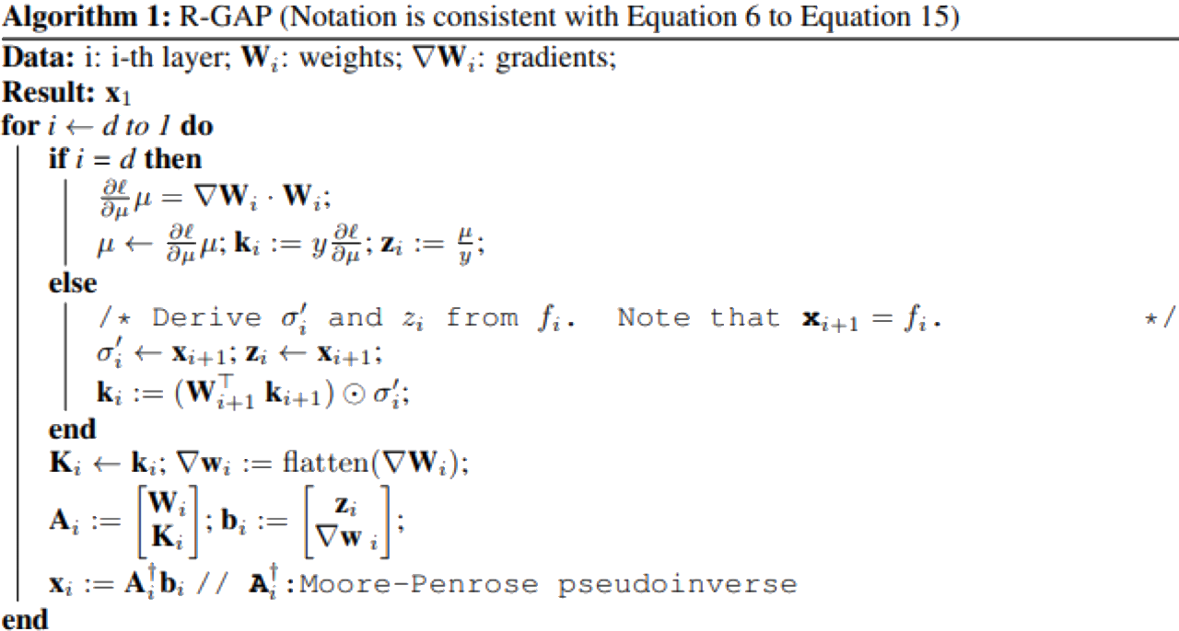
Comparison
R-GAP(Analytics-based)
Notes:
Reconstruction from last layer (fully connected) to first (conv)
Initialize k & z
Get ki = (WT k(i+1)) elementwise mult (σi ’) σi ’ : derivative of leakyReLU
( with “out”, k, g, w ) to get xi ( for calculation of next layer) “out” : input of leakyReLU g : gradients w : weights
Note: No pooling layer in CNN of this repo

Slide 7
Comparison
DLG(Optimization-based)
Randomly generate fake data & fake labels.
Calculate the loss and gradient using the prediction results from the fake data and fake labels.
Compute the difference between the real gradient and the fake gradient, and use this to update the fake data and fake labels to restore the original data.
Optimization-based attack methods simulate the process of approximating the fake gradient to the real gradient to restore the original data.

Slide 8
Comparison
R-GAP(Analytics-based)
Reverse-engineer the feature map based on the gradients and weight.
Then use the least square solution to trace back the input of each layer.
After reaching the first layer, the original data can be obtained.
Analytics-based attack methods use the mathematical properties to retrieve the input of each layer to restore the original data from the first layer.

Slide 9
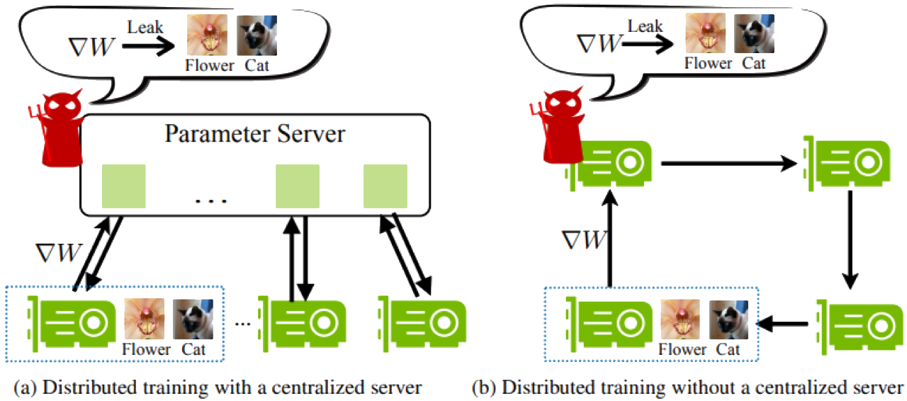
Observations
DLG is not always able to work on clients.

Slide 10
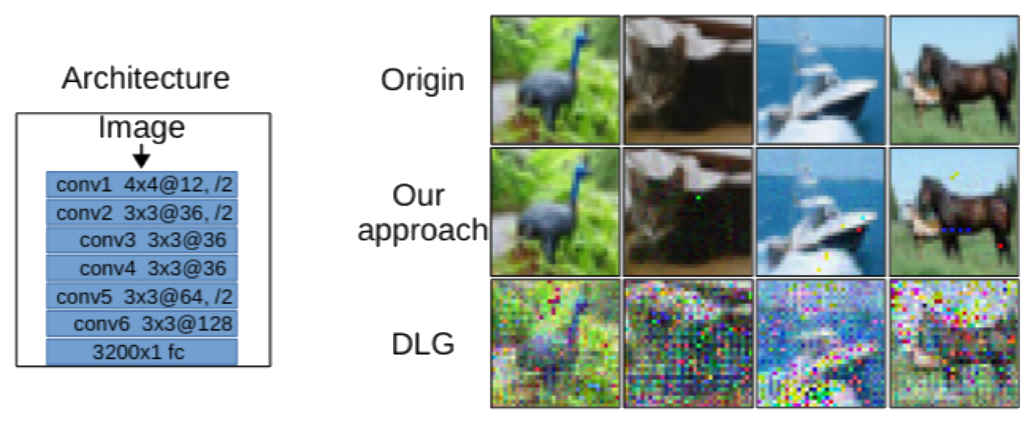
Observations
CNN implemented in R-GAP doesn’t include pooling layers.

